Slide 1
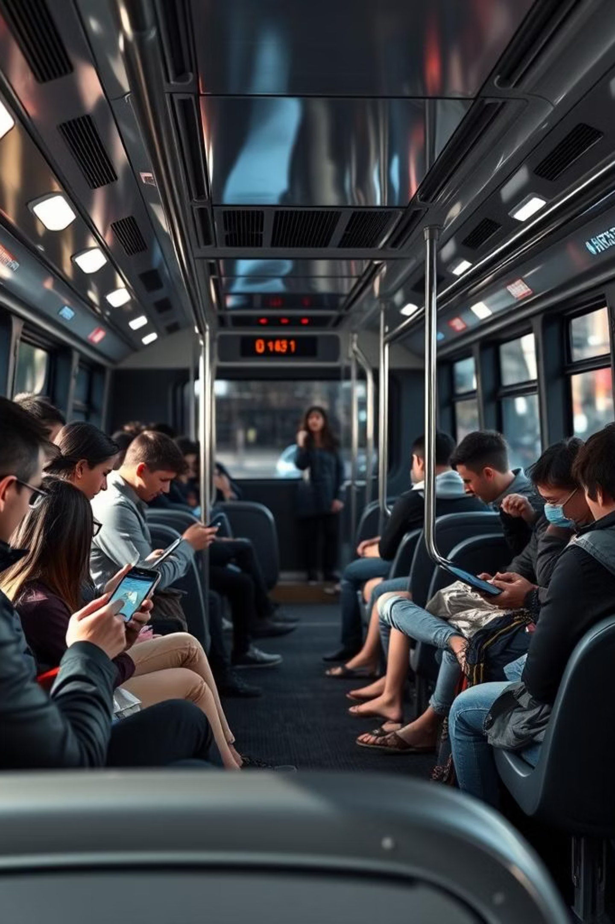
PMPML ONLINE TICKET BOOKING
Presented by :
Kiran Dattatray Lambate (250245920040)
Sharayu Chavdas Vanjari (250245920081)
Pratiksha Ashok Nalawade (250245920065)
Rohan Girish Kulkarni (250245920043)
Akshay Rajaram Gore (250245920009)

Slide 2
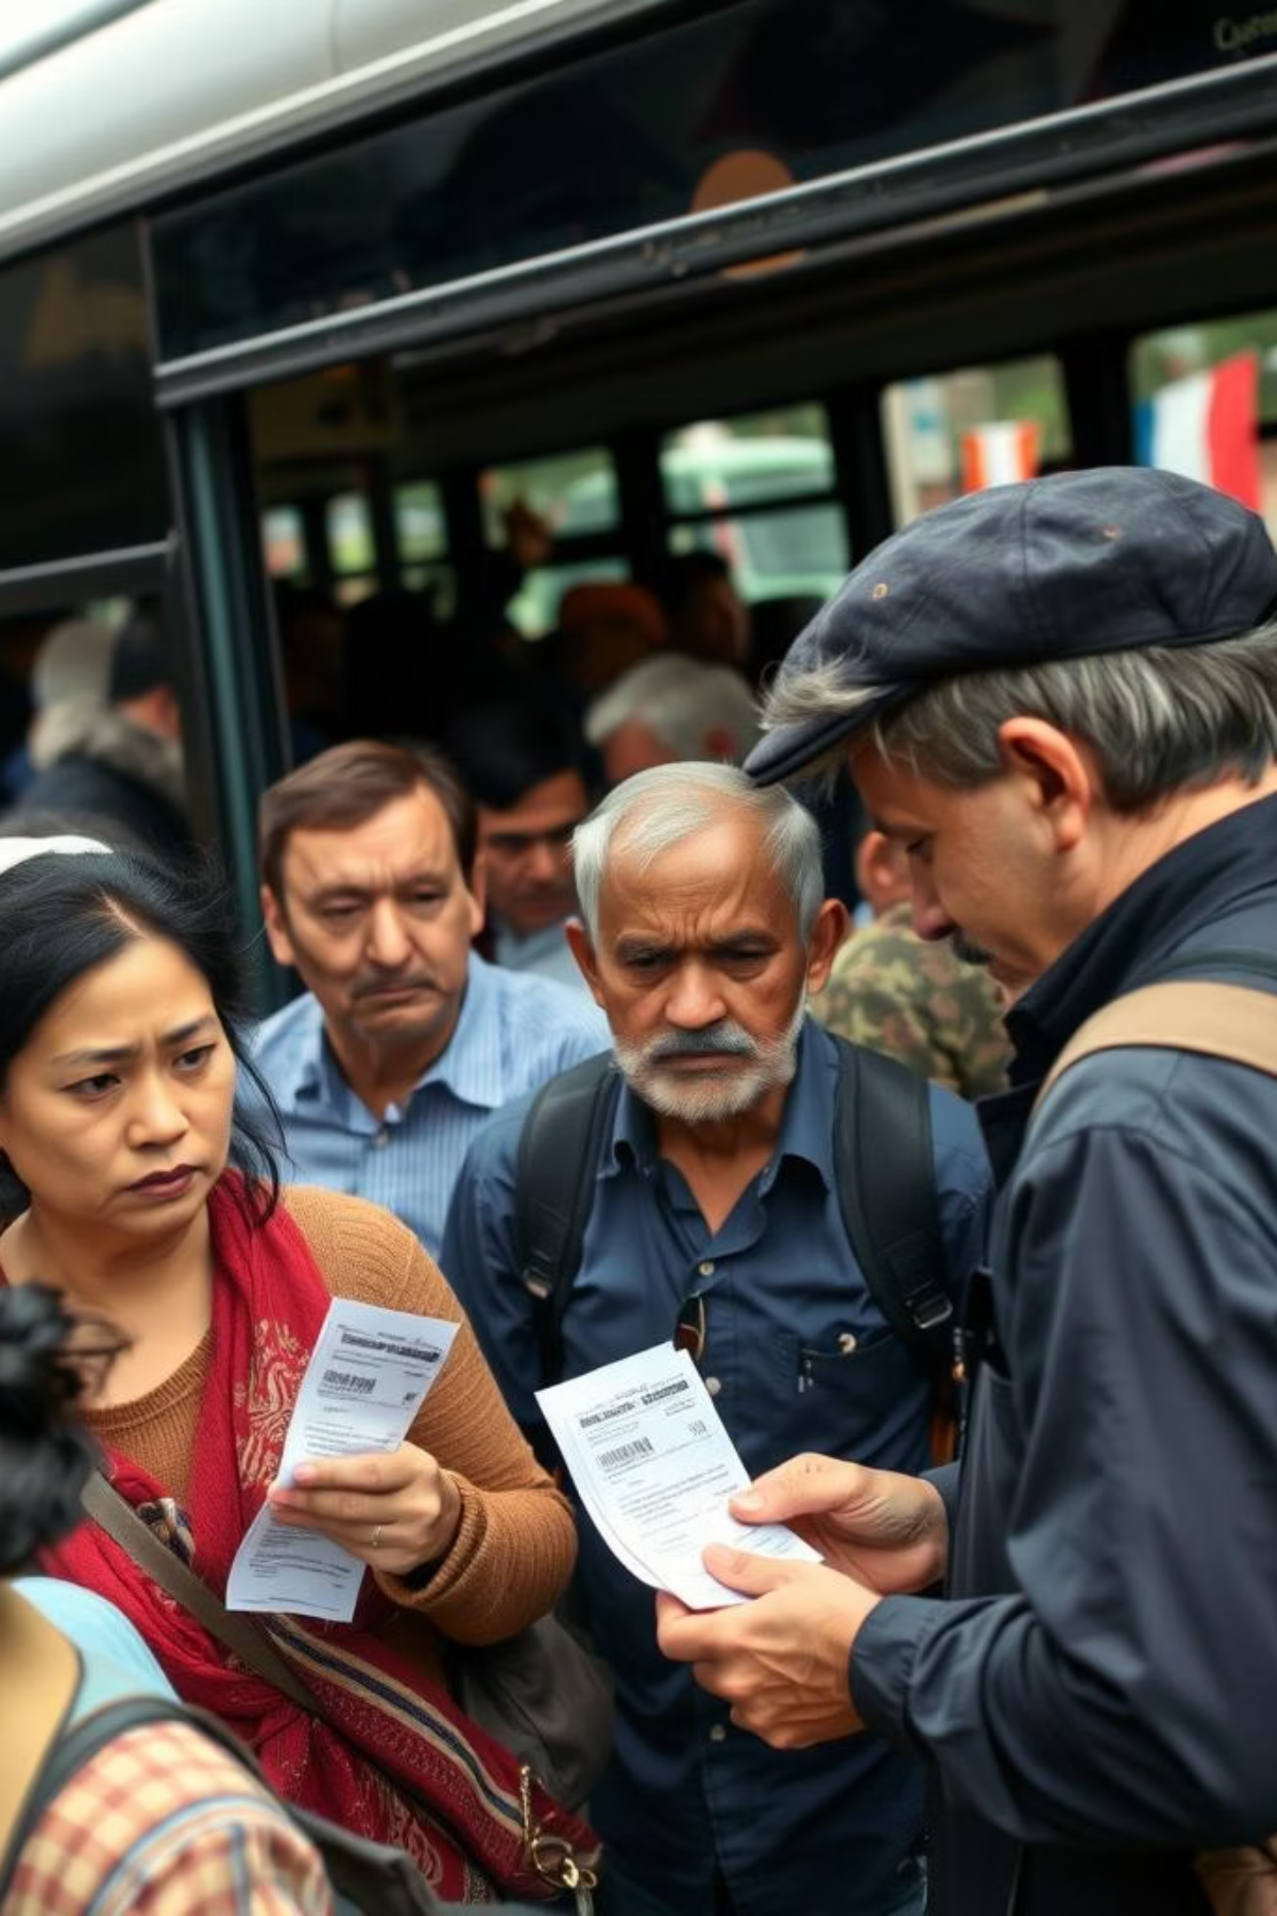
Overview
The PMPML Online Ticket Booking Project is a digital solution designed to modernize public bus travel in Pune. Through a dedicated mobile app, it offers commuters a convenient, cashless, and paperless way to book tickets, access real-time bus information, and plan their journeys efficiently.

Slide 3
OBJECTIVES
The main objective of the PMPML Online Ticket Booking Project is to digitally transform Pune's public bus ticketing system, enhancing convenience, efficiency, and user experience for commuters.

Slide 4
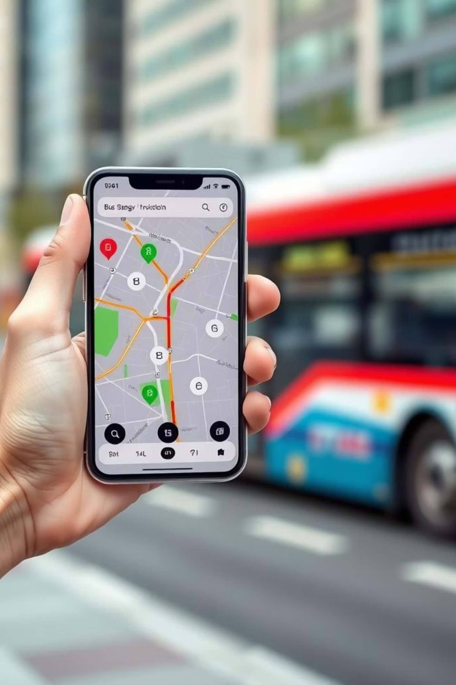
Problem Definition:
Develop an improved ticketing system for PMPML with features like QR-based digital tickets, multilingual support, and extended validity, enhancing accessibility, convenience, and security for a more inclusive travel experience.

Slide 5
Key Features of PMPML Online Ticket Booking Project
Secure Sign-Up/Login/Profile - Safe user access with secure registration and account management
Digital Ticket Booking - Book tickets online with UPI, cards, or wallets
QR Code Ticket - Each ticket gets a QR code for fast, contactless validation
Ticket Transfer - Transfer tickets to other registered users before the ride
Ride Postponement - Reschedule rides if seats are available and within policy
Ticket Cancellation - Cancel tickets with refunds/credits as per policy
Live Bus Tracking - Real-time bus location and updates on delays or changes
Feedback and Support - Submit complaints or feedback directly through the app
Admin Panel Dashboard - for staff to manage operations and monitor bookings

Slide 6
Software Requirements and Specifications(Front End: React | Back End: .NET | Database: MySQL)
Front End:
React Requirements: ReactJS (latest stable version)Node.js (for development/build)Responsive, accessible UI Integration with RESTful APIs
2. Back End:
.NET Requirements: .NET 6 or higher (ASP.NET Core)RESTful API development Entity Framework Core (ORM)JWT/OAuth authentication Payment gateway integration
Database:
MySQL Requirements: MySQL Community Server 8.xSecure connection (SSL/TLS)Regular backups
4. Deployment Tools: AWS
5. API Provider Payment Gateway API: Razorpay

Slide 7
UML Diagrams
1) Use case diagram
2) Class diagram
3) Sequence diagram
4) Activity diagram
5) Dataflow diagram
6) ER diagram

Slide 8
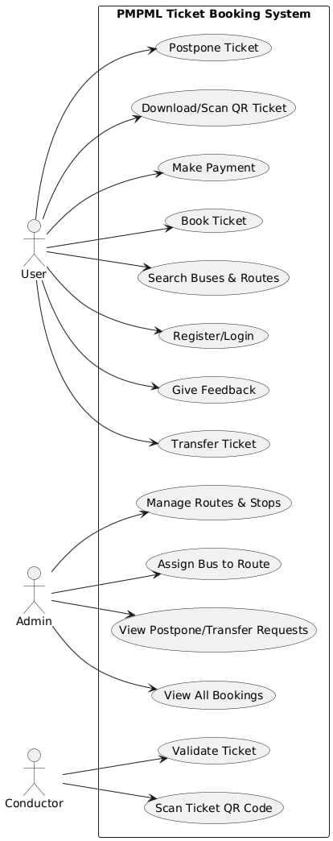
Use Case Diagram

Slide 9
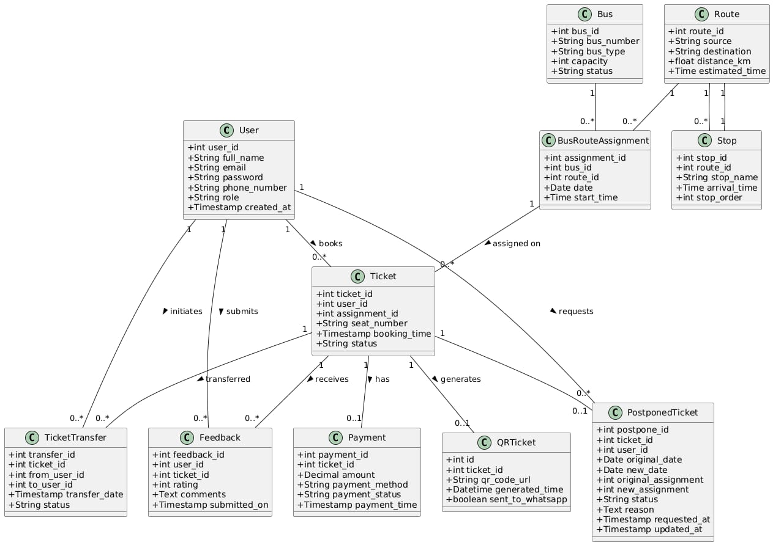
Class Diagram

Slide 10
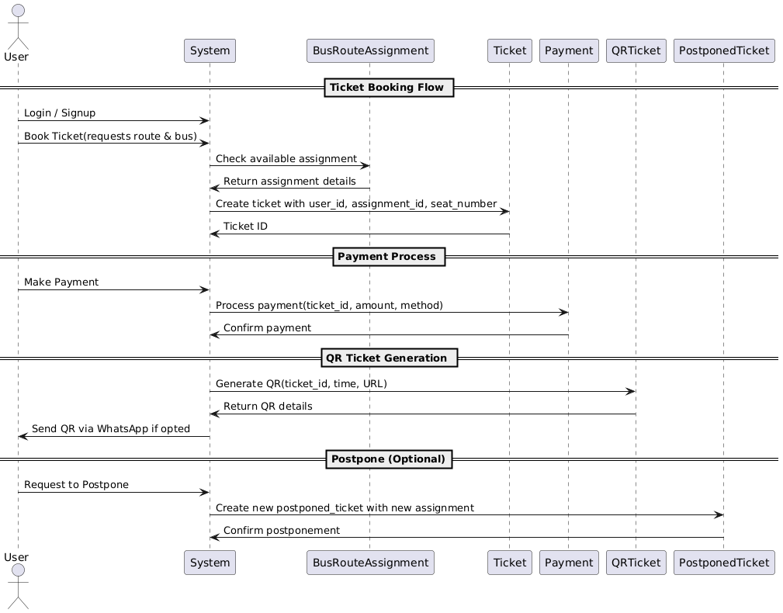
Sequence Diagram

Slide 11
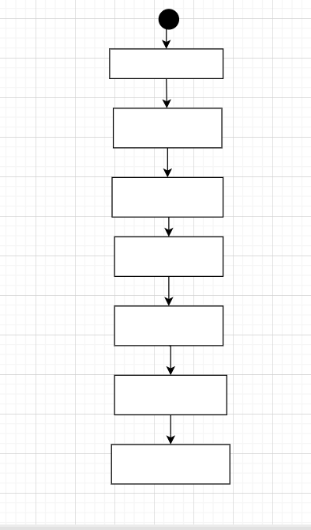
Activity Diagram
Login
Search for Routes
Select your route
Check & Select
Available buses
Select your seats
Make Payment
Download the
Ticket
Confirm the
Ticket

Slide 12
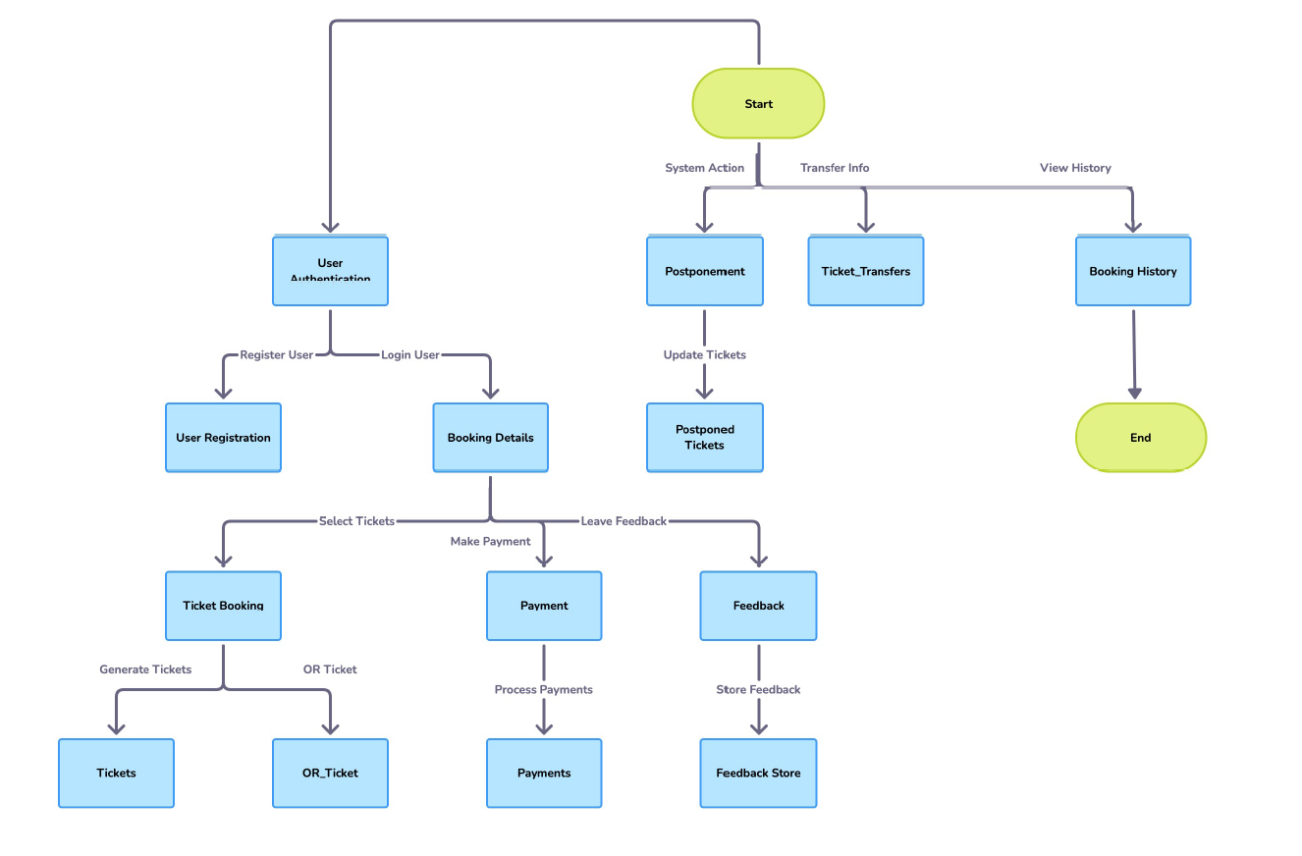
Dataflow Diagram

Slide 13
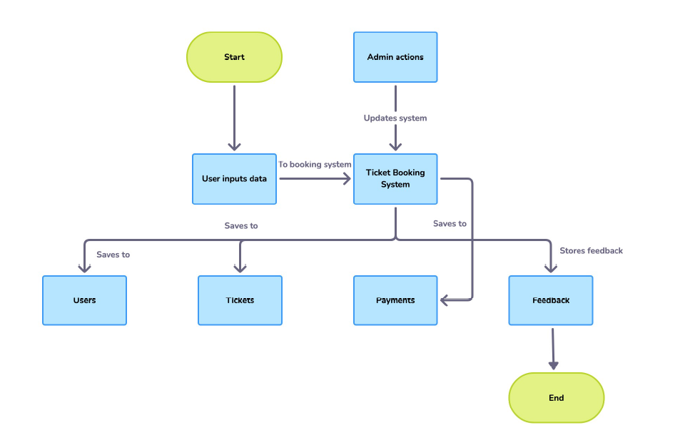

Slide 14
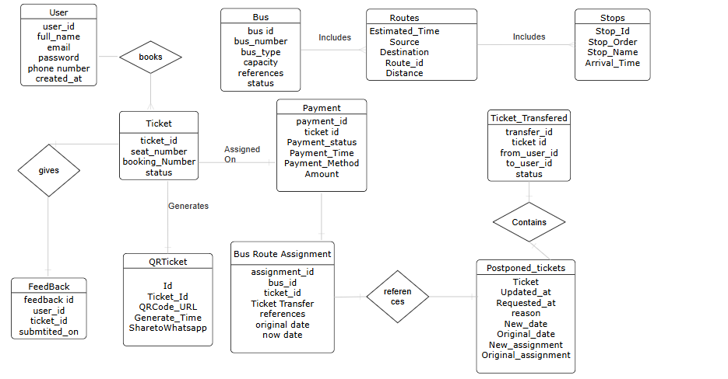
ER Diagram

Slide 15
User Interface of the Project
1) Login page
2) Search Routes
3) Available Buses
4) Selection of Buses
5) Making Payment
6) Download Ticket
7) My Ticket
8) Transfer Ticket
9) Cancel & Refund
10) Admin Panel

Slide 16
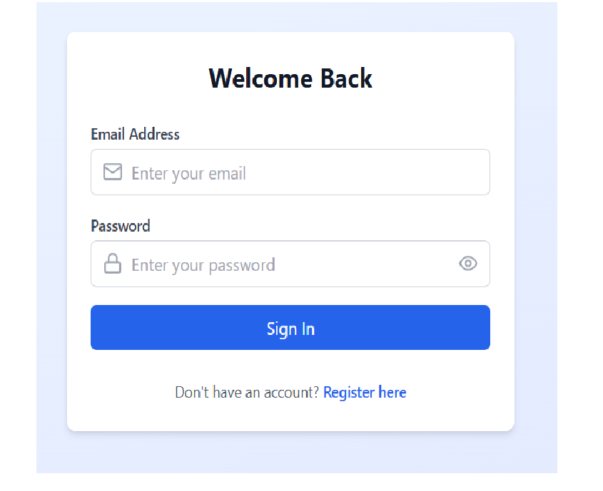
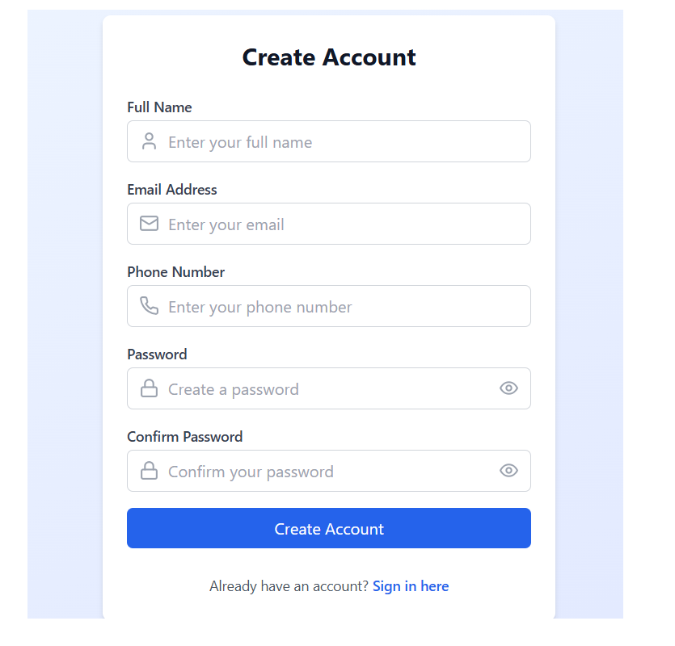
1. Login Page

Slide 17
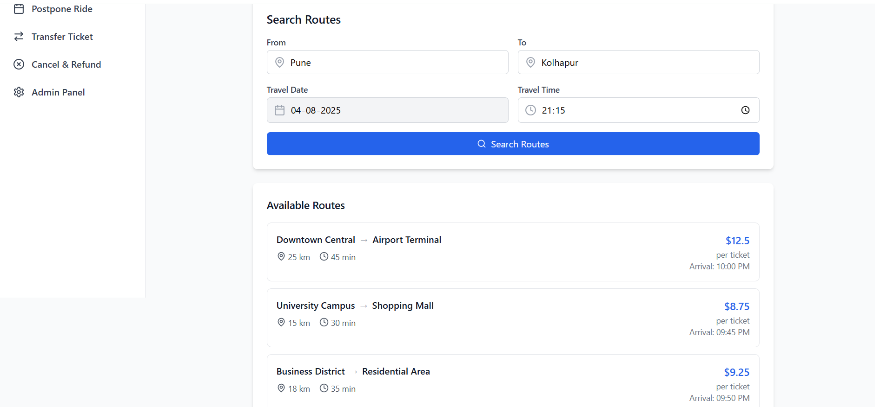
2. Search Routes

Slide 18
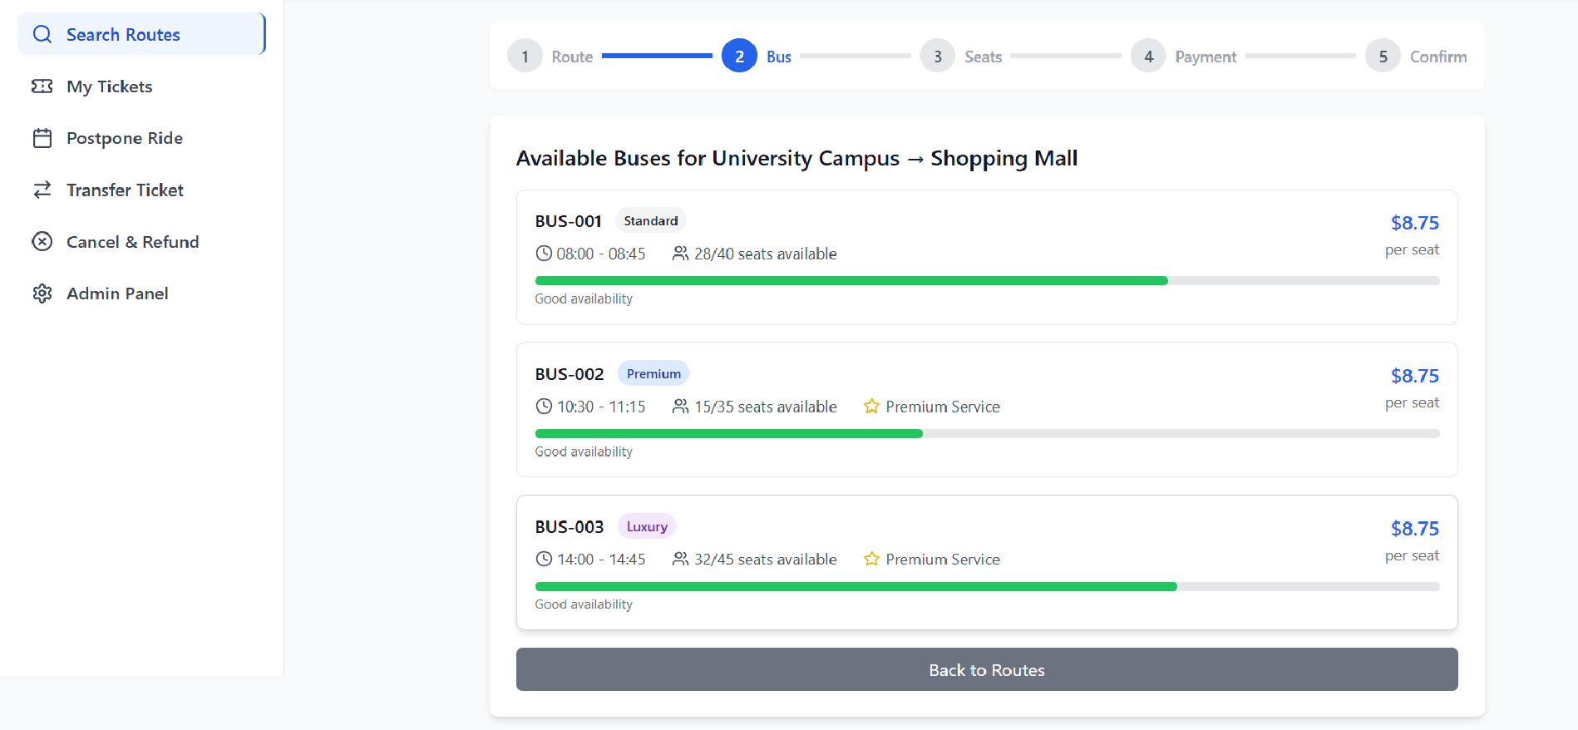
3. Available Buses

Slide 19
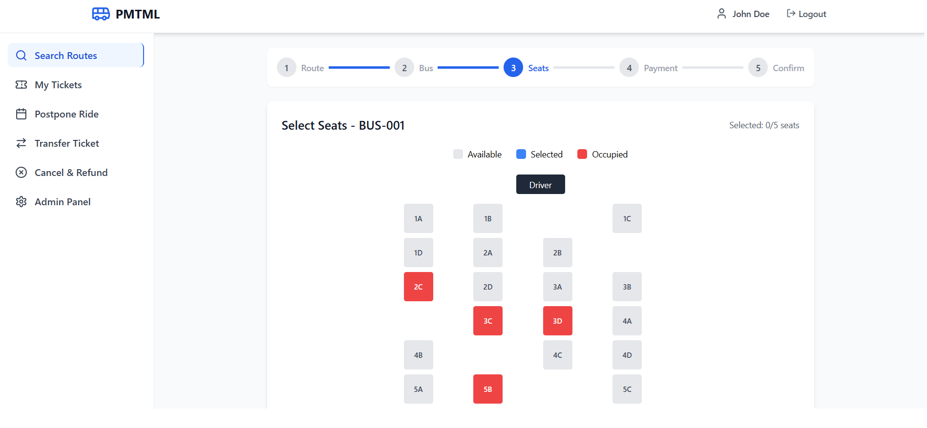
4. Selection of seats

Slide 20
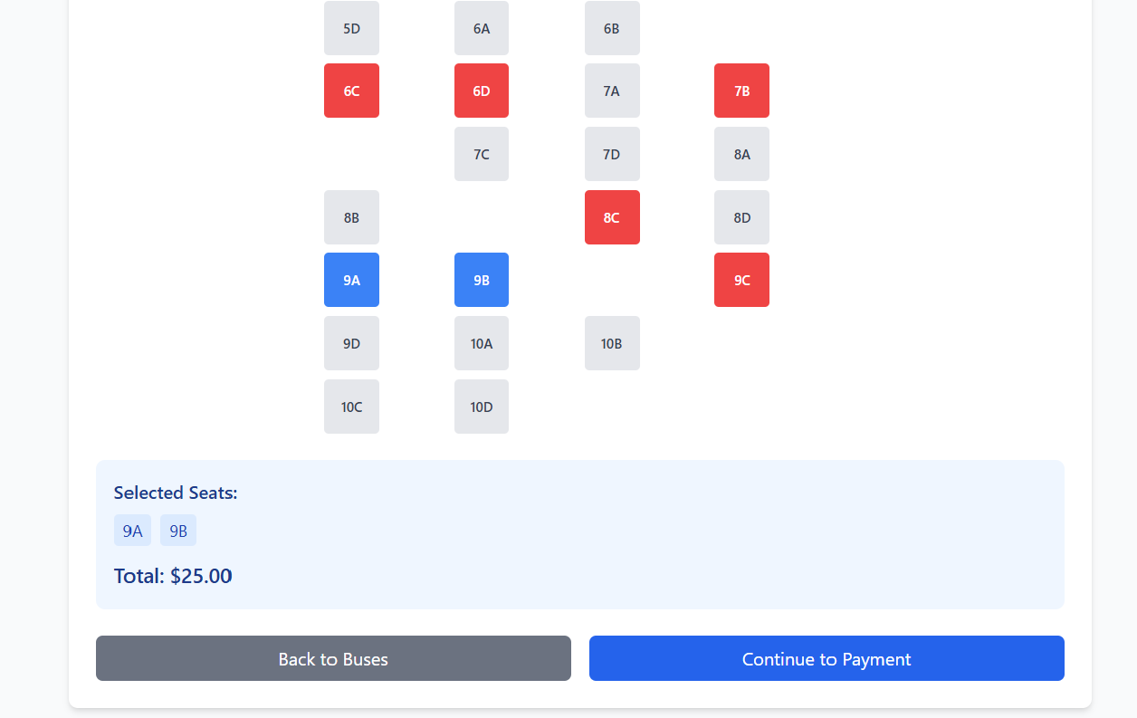

Slide 21
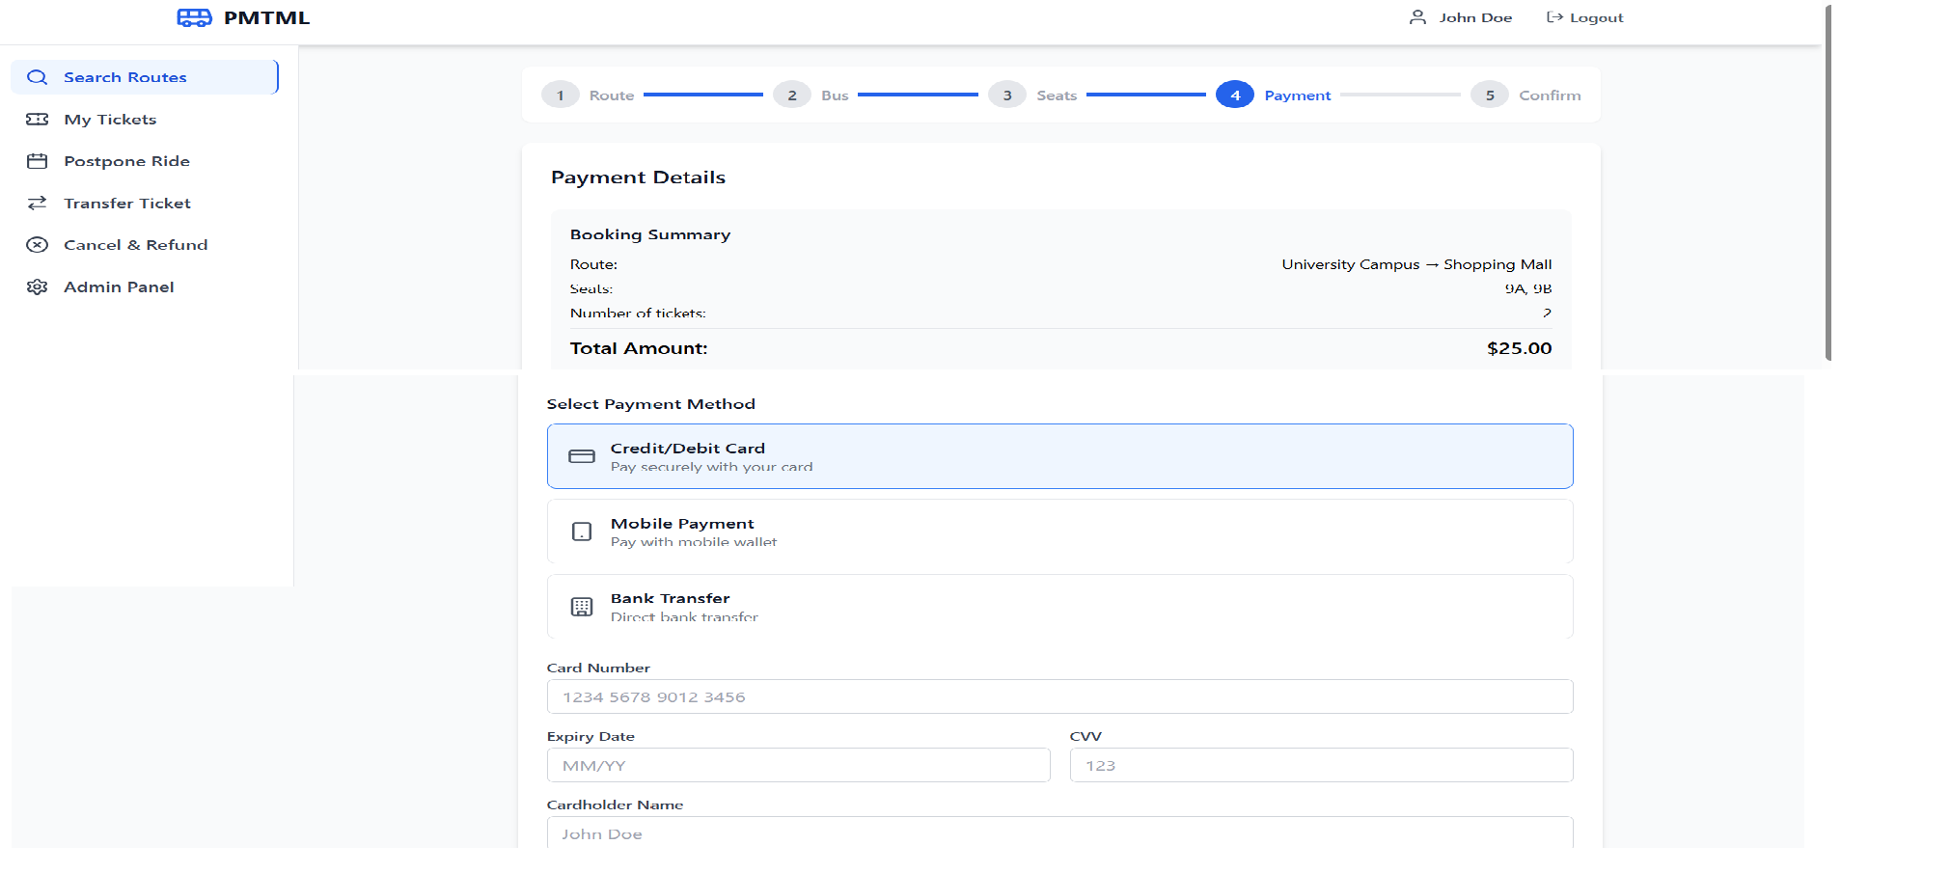
5. Making Payment

Slide 22
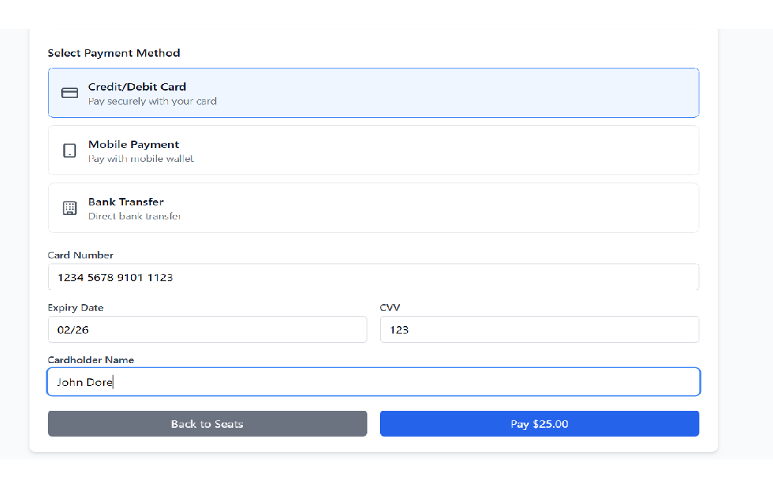
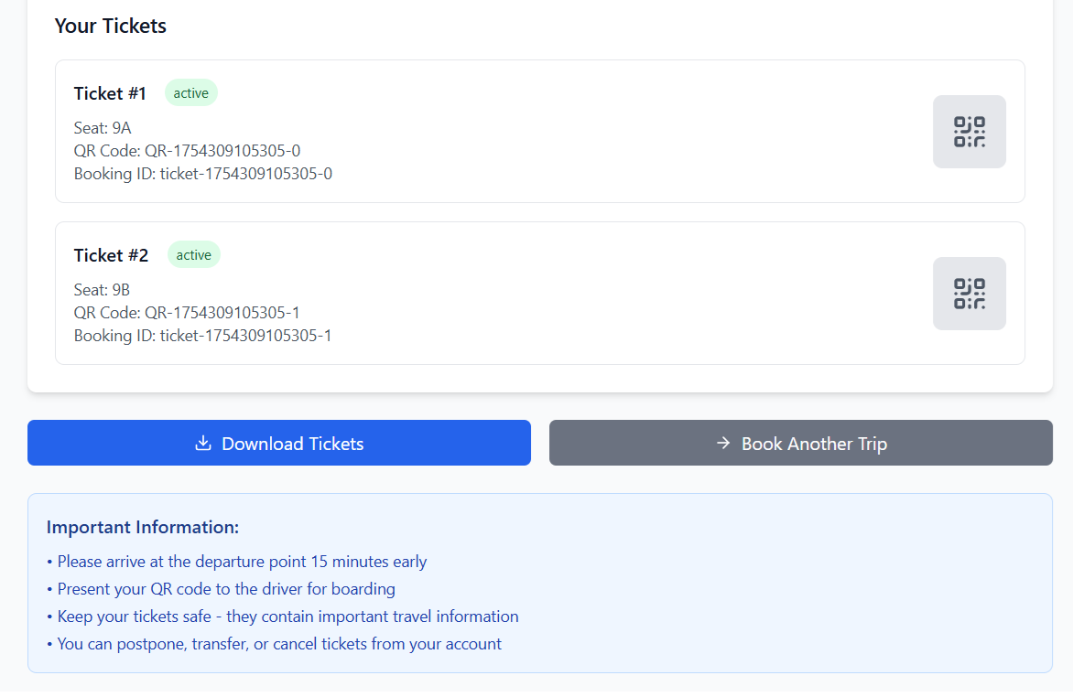
6. Download Ticket

Slide 23
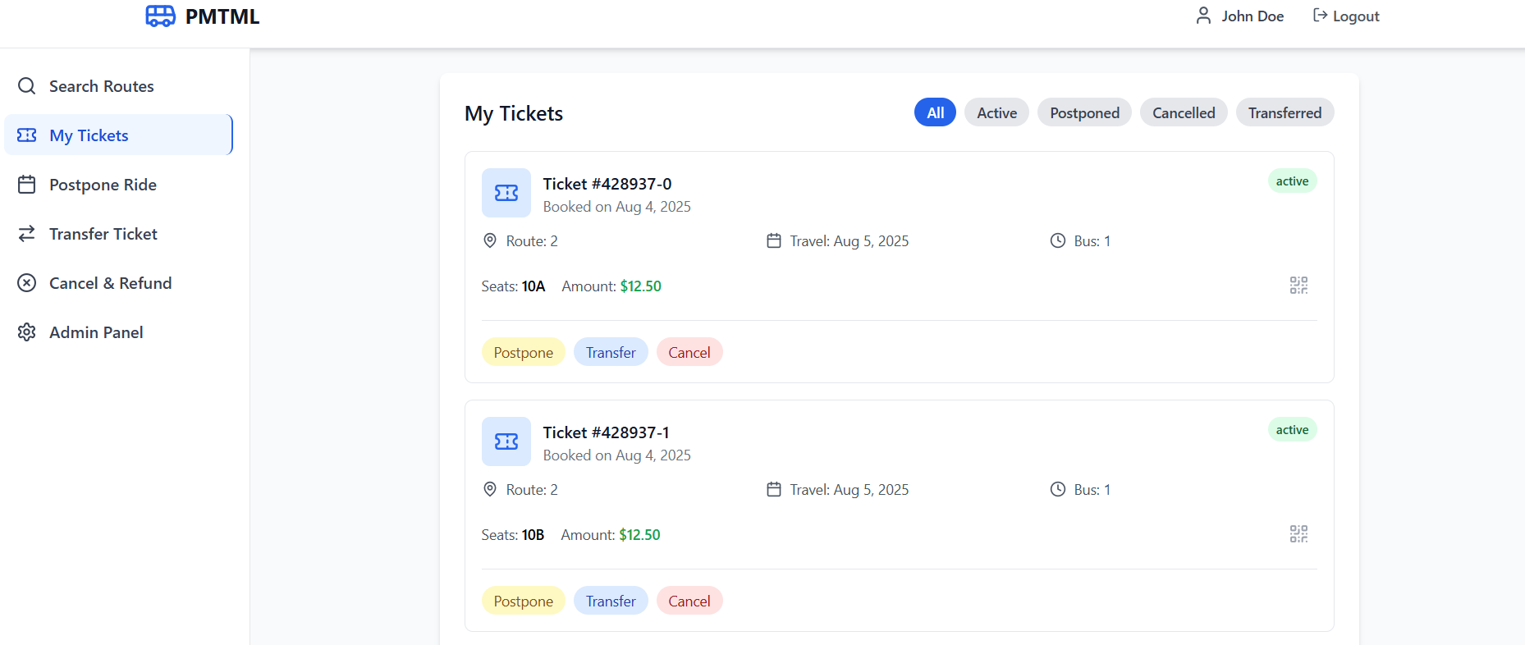
7. My Tickets

Slide 24
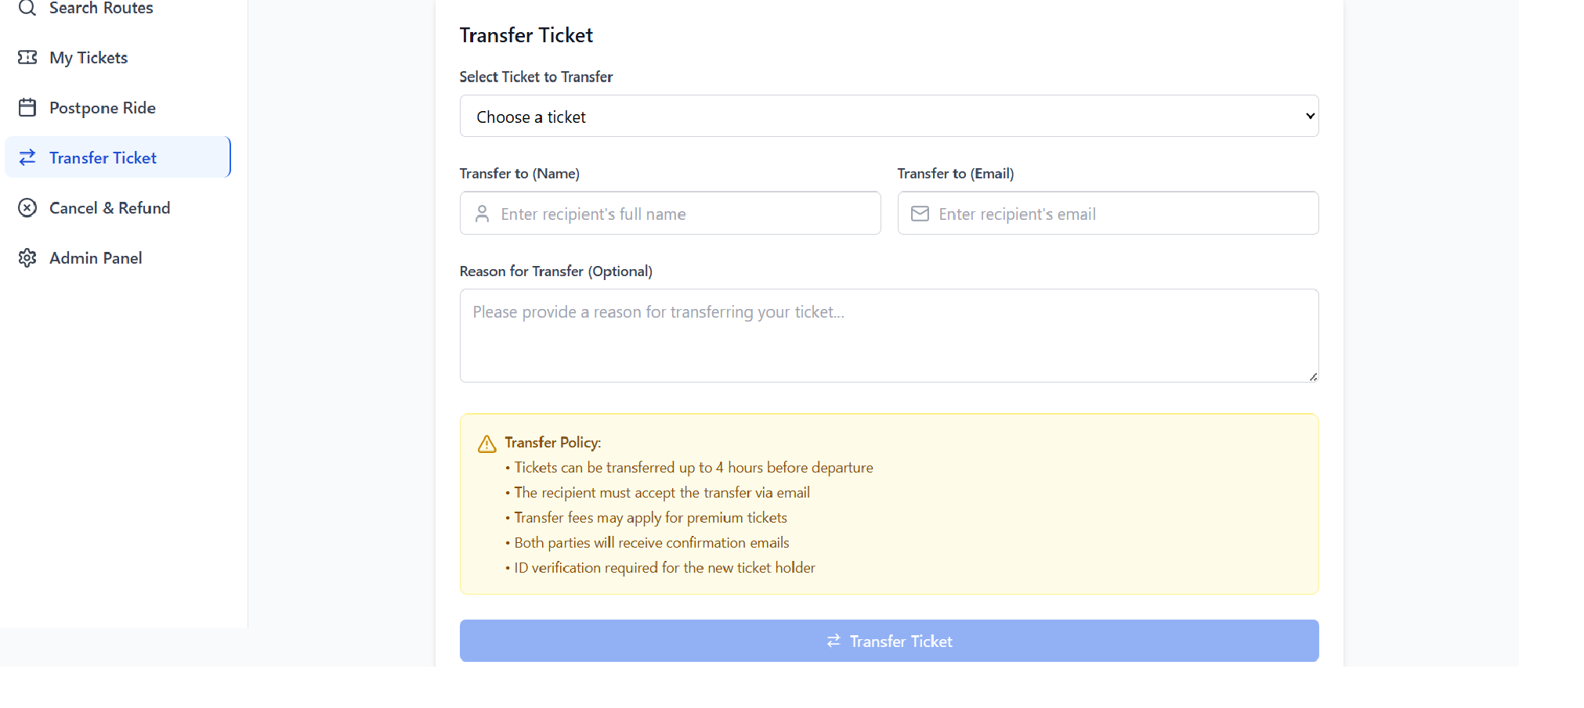
8. Transfer Ticket

Slide 25
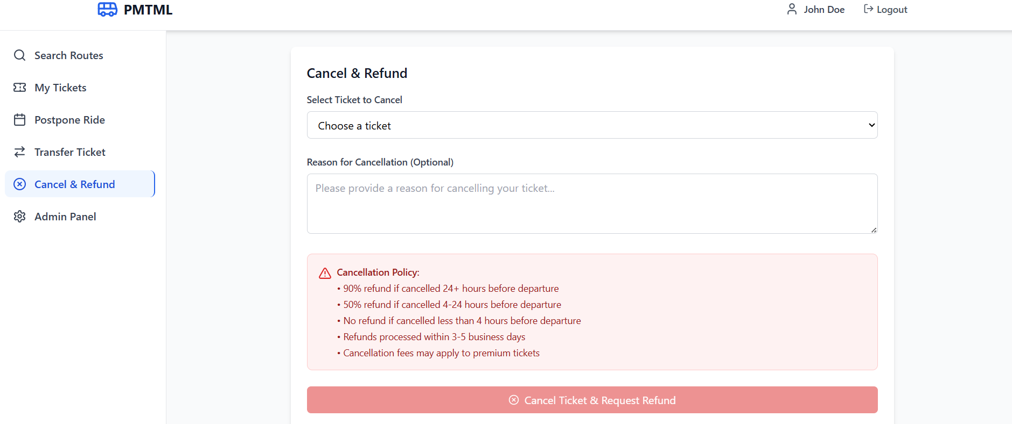
9. Cancel & Refund

Slide 26
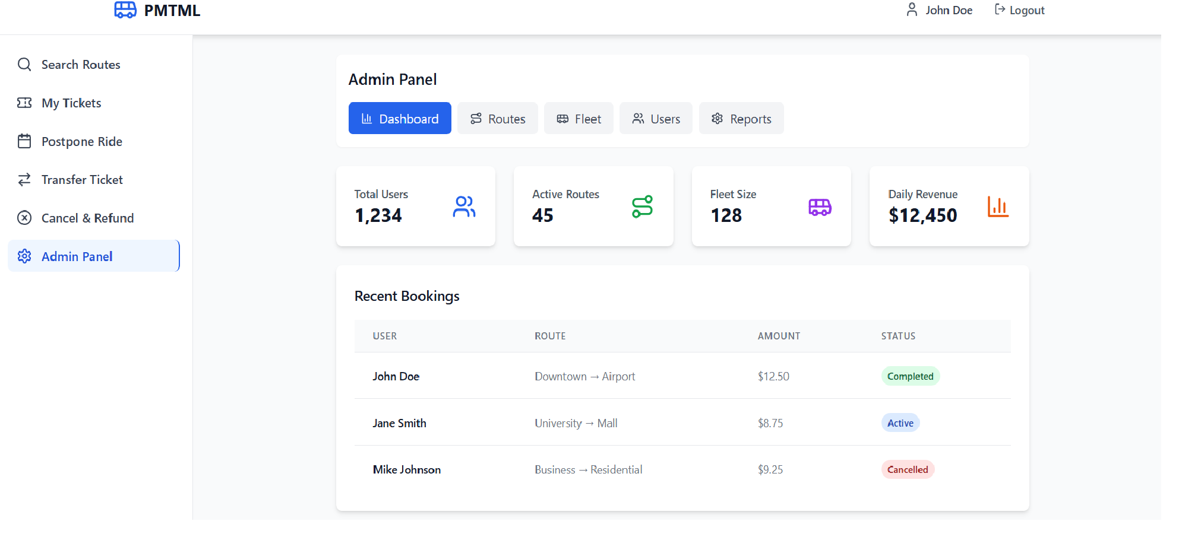
10. Admin Panel

Slide 27
Future Scope of the PMPML Online Ticket Booking Project:
1. Enhanced Accessibility
2. Offline Functionality
3. Enhanced Security and Compliance
4. Real-Time Communication5.Green Initiatives

Slide 28
Conclusion:
The PMPML Online Ticket Booking Project modernize Pune’s public transport with a secure, user-friendly platform built using React, .NET, and MySQL. It offers digital ticketing, QR code validation, ticket transfer, ride changes, cancellations, and real-time bus tracking to enhance the commuter experience.

Slide 29
THANK YOU

